Slide 1
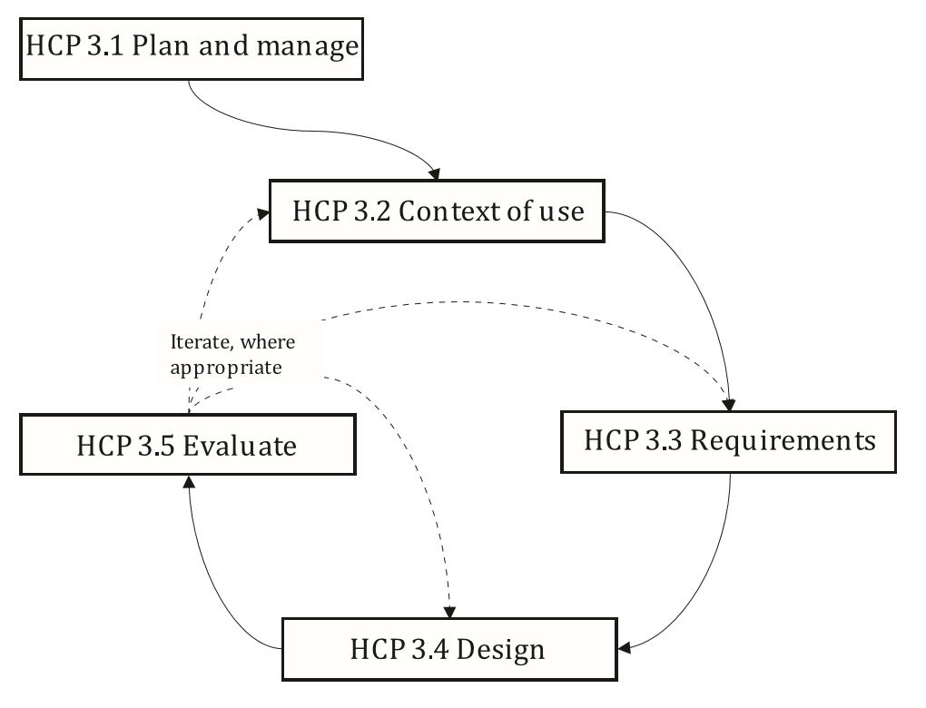
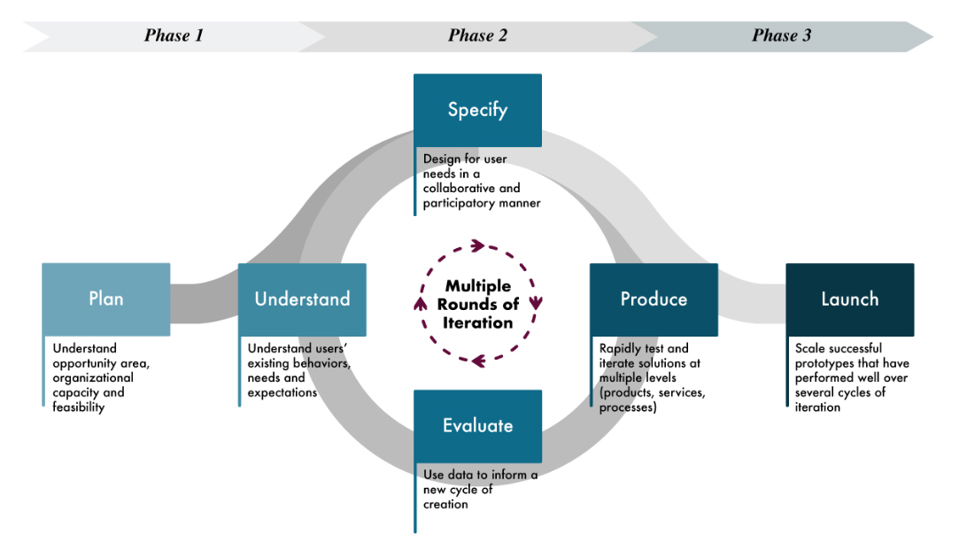
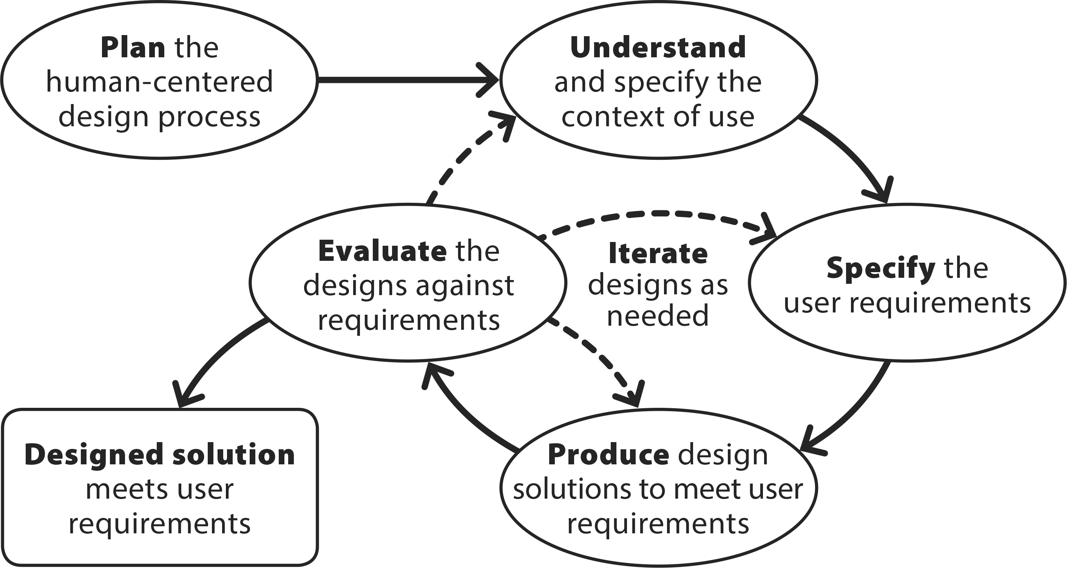
Ensure
Executives and management
Vision and policies set across enterprise
“Process Categories associated with different areas of responsibility.”
Plan and manage
Objectives, threats and opportunities, extent, processes and activities within project
Context of use
Identify intended user, differentiate user groups, and other aspects of context
Requirements
Identify user needs, specify user requirements, negotiate user requirements in project context
Design
Design solution, specify user-system interaction, refine interface
Evaluate
Plan (what to evaluate and how) and carry out
Enable
Product and HCD managers
Infrastructure in place: Processes, methods, tools, and qualified roles
Execute
Project managers Process outputs are produced
Introduce
Operations, service, and support managers
Transition into operation

Slide 2
ISO frames on areas of responsibility (as opposed to phases)
ISO places Plan and Manage in the same area of responsibility (execute) as the iterative cycle
ISO depicts Plan and Manage as outside the iterative cycle but cites consideration of Context of Use and User Requirements as within the scope of responsibility
Figure suggests Understand is last in cycle. Consider quarter clockwise turn. Also…
Figure eliminates dynamic change in the scale of iterative loop represented in ISO figure. That is, second iteration need not re-visit Understand and Specify.
Activities under Plan and Manage (examples)
Review context of use to identify HCD quality objectives
Assess harm that results from poor human-centered quality
Identify HCD process outcomes to be achieved to meet poor human-centered quality objectives
Identify which human factors data are required by the project
Plan overall set of HCD activities to be performed…
Customize HCD procedures and associated tools and methods as appropriate…
Plan each HCD process activity in terms of resources

Slide 3
Frame Discover Design Deliver
Launch
Plan
Understand
Manage
Evaluate
Specify
Produce

Slide 4
Understand
Identify intended user, differentiate user groups, and other aspects of context
(Validate &) DELIVER
FRAME
Understand
DISCOVER
Evaluate
Specify
Plan and manage
Objectives, threats and opportunities, extent, processes and activities within project
Context of use
Identify intended user, differentiate user groups, and other aspects of context
Requirements
Identify user needs, specify user requirements, negotiate user requirements in project context
Design
Design solution, specify user-system interaction, refine interface
Evaluate
Plan (what to evaluate and how) and carry out
DESIGN
Specify
Identify user needs, specify user requirements, negotiate user requirements in project context
Produce
Produce
Design solution, specify user-system interaction, refine interface
Evaluate
Measure and assess ability of design to support users’ task goals

Slide 5
Understand
Identify intended user, differentiate user groups, and other aspects of context
DELIVER
FRAME
DISCOVER
Understand context of use and specify user requirements
DESIGN
Produce design solutions to evaluate and ultimately validate
Plan and manage
Objectives, threats and opportunities, extent, processes and activities within project
Context of use
Identify intended user, differentiate user groups, and other aspects of context
Requirements
Identify user needs, specify user requirements, negotiate user requirements in project context
Design
Design solution, specify user-system interaction, refine interface
Evaluate
Plan (what to evaluate and how) and carry out
Specify
Identify user needs, specify user requirements, negotiate user requirements in project context
Produce
Design solution, specify user-system interaction, refine interface
Evaluate
Measure and assess ability of design to support users’ task goals

Slide 6
FRAME
DISCOVER
DESIGN
DELIVER
Understand
Produce
Specify
Evaluate
Plan and manage
Objectives, threats and opportunities, extent, processes and activities within project
Context of use
Identify intended user, differentiate user groups, and other aspects of context
Requirements
Identify user needs, specify user requirements, negotiate user requirements in project context
Design
Design solution, specify user-system interaction, refine interface
Evaluate
Plan (what to evaluate and how) and carry out
Understand
Identify intended user, differentiate user groups, and other aspects of context
Specify
Identify user needs, specify user requirements, negotiate user requirements in project context
Produce
Design solution, specify user-system interaction, refine interface
Evaluate
Measure and assess ability of design to support users’ task goals

